Slide 1
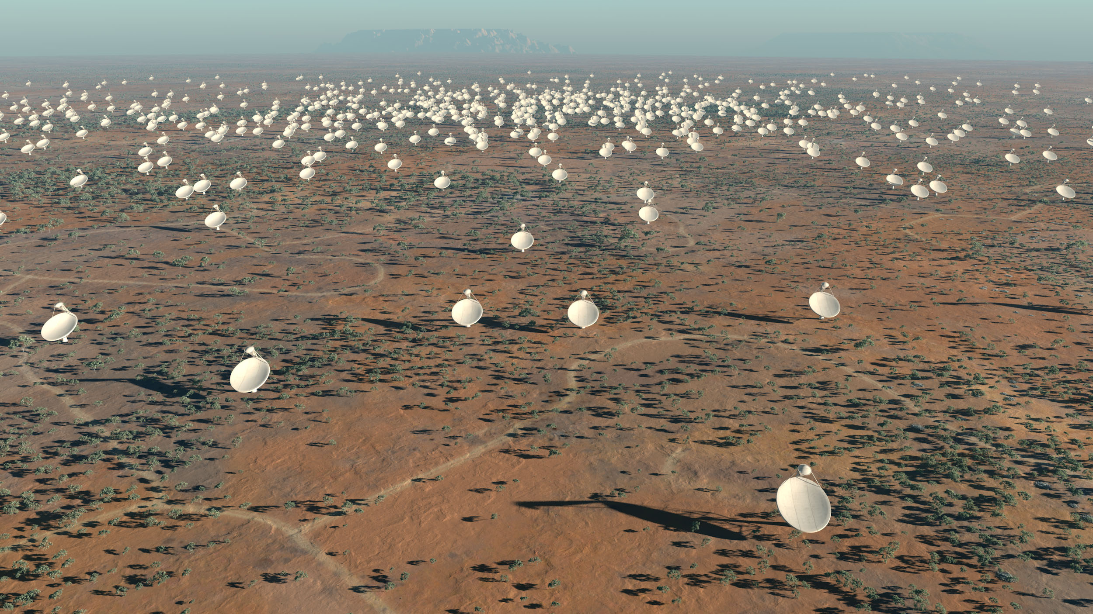

Radio Astronomy,
SKA & Data Science
Oleg Smirnov (Rhodes University & SKA SA)

Slide 2
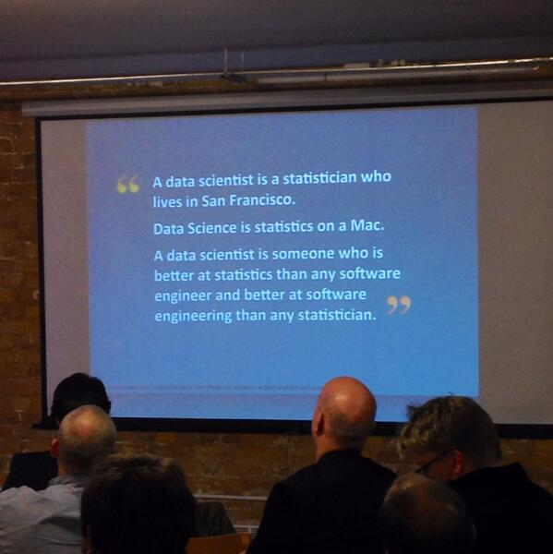
What Is Data Science?

Slide 3
What Is The SKA?
The Square Kilometre Array will be the biggest radio telescope in the world, and one of the biggest and most challenging projects in science
  The SKA Organization: Australia, Canada, China, Germany, Italy, Netherlands, New Zealand, South Africa, Sweden, UK
Cost R20+ billion
On 25 May 2012, the SKA Organisation announced that the SKA would be jointly sited in South Africa and Australia, with ~70% coming to South Africa

Slide 4
What Is The SKA?
Kilometre?
Array?
The Square Kilometre Array will be the biggest radio telescope in the world, and one of the biggest and most challenging projects in science
  The SKA Organization: Australia, Canada, China, Germany, Italy, Netherlands, New Zealand, South Africa, Sweden, UK
Cost R20+ billion
On 25 May 2012, the SKA Organisation announced that the SKA would be jointly sited in South Africa and Australia, with ~70% coming to South Africa
What's a “radio”
telescope?...
What are the
challenges?
(Apart from the
price tag?)
What kind
of science?
...and how do we
take 70% of one?

Slide 5
What Is a Radio Telescope
A radio telescope collects radiation in in the radio band (as opposed to the visible light band)

Slide 6
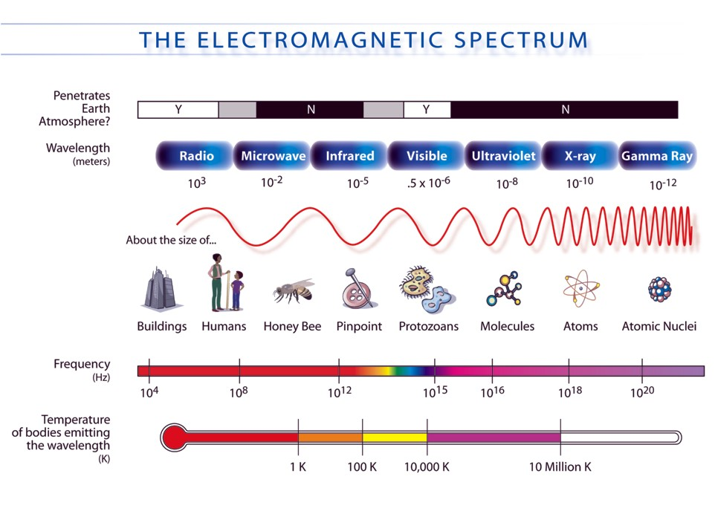
Why Radio?
Physical processes in the universe emit radiation across the entire electromagnetic spectrum
Visible light tells only a small part of the story
image: http://mynasadata.larc.nasa.gov

Slide 7
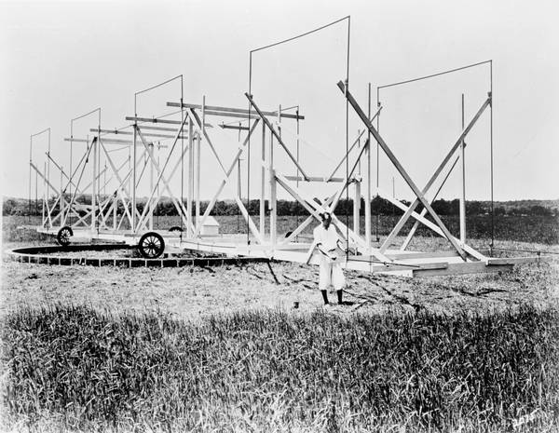
1933: Karl Jansky, The Accidental Pioneer
Jansky, a radio engineer
at Bell Labs, constructs
a large rotating antenna
to study sources of radio
static
...and finds one such
source repeating on a
near-daily (23h56m) cycle
Eventually realizes it's
radiation from the Milky
Way – our galaxy
Has a unit (flux density) named after him (1 Jy = 10⁻²⁶ W m⁻² Hz⁻¹),
and now a radio observatory: the Karl G. Jansky Very Large Array
Eureka!

Slide 8
1933: Karl Jansky, The Accidental Pioneer
Jansky, a radio engineer
at Bell Labs, constructs
a large rotating antenna
to study sources of radio
static
...and finds one such
source repeating on a
near-daily (23h56m) cycle
Eventually realizes it's
radiation from the Milky
Way – our galaxy
Has a unit (flux density) named after him (1 Jy = 10⁻²⁶ W m⁻² Hz⁻¹),
and now a radio observatory: the Karl G. Jansky Very Large Array
WTF?

Slide 9
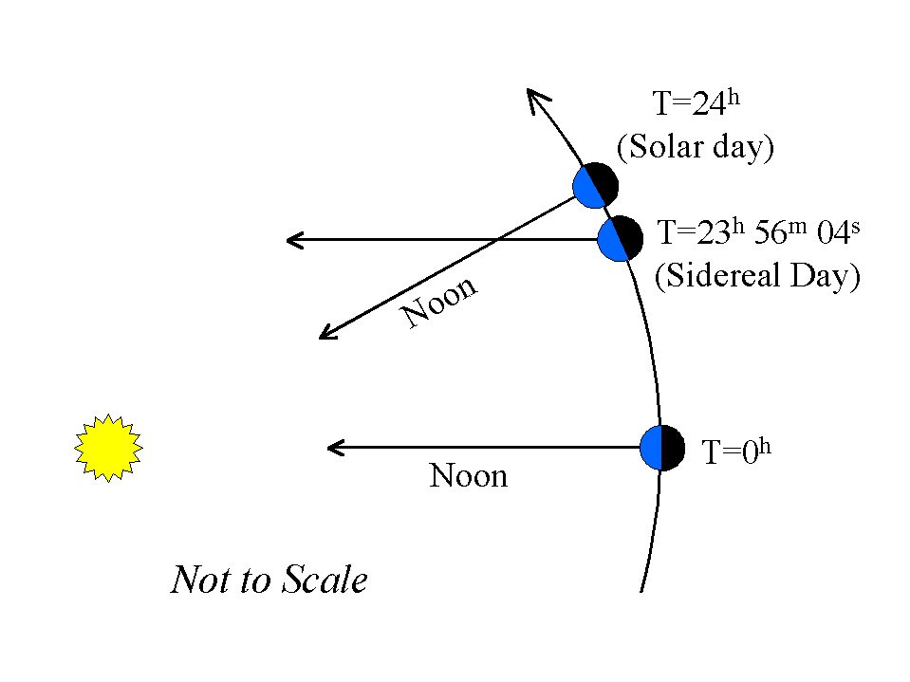
1933: Karl Jansky, The Accidental Pioneer
Jansky, a radio engineer
at Bell Labs, constructs
a large rotating antenna
to study sources of radio
static
...and finds one such
source repeating on a
near-daily (23h56m) cycle
Eventually realizes it's
radiation from the Milky
Way – our galaxy
Has a unit (flux density) named after him (1 Jy = 10⁻²⁶ W m⁻² Hz⁻¹),
and now a radio observatory: the Karl G. Jansky Very Large Array

Slide 10
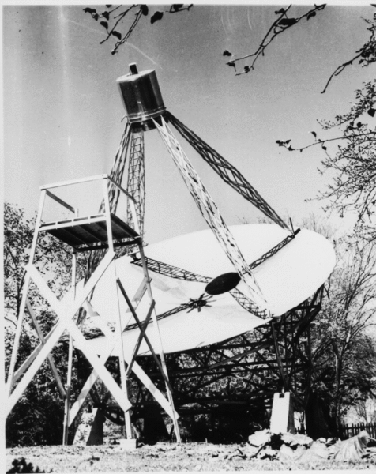
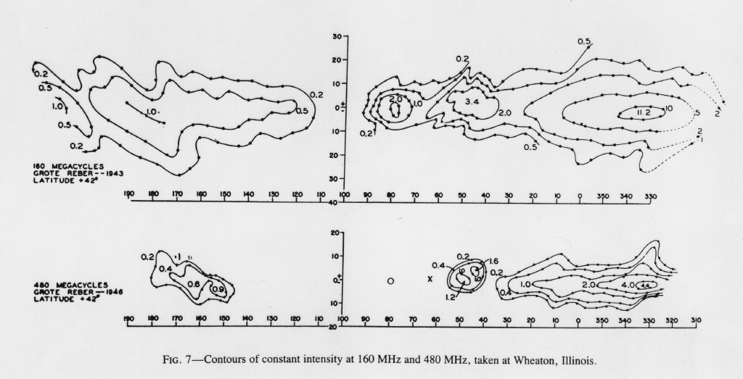
1937: Grote Reber, Amateur Supreme
Makes the world's first purpose-built
radio telescope (9 metres!)
  ...in his own back yard in
  Wheaton, Illinois
Sets the pattern for future designs
Confirms Jansky's discovery
Maps out radiation from the Milky Way
WTF?

Slide 11
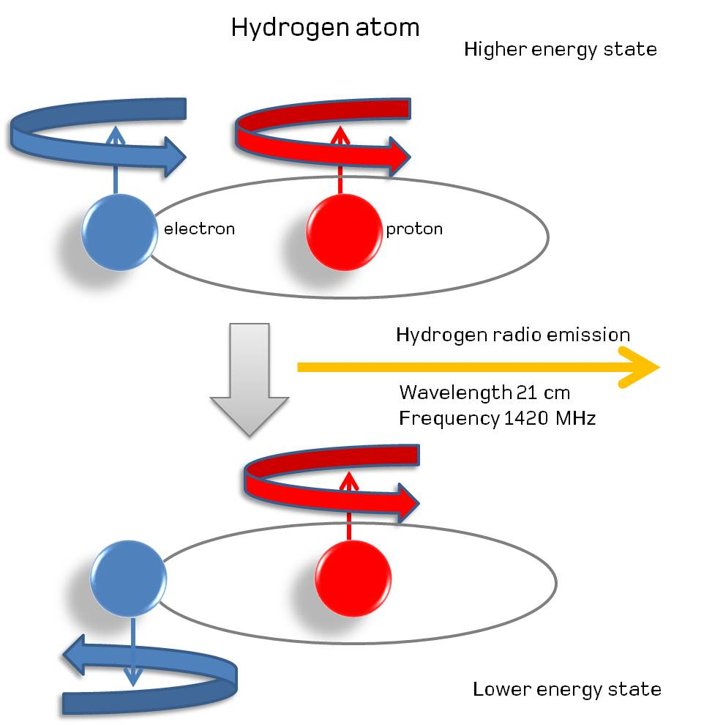
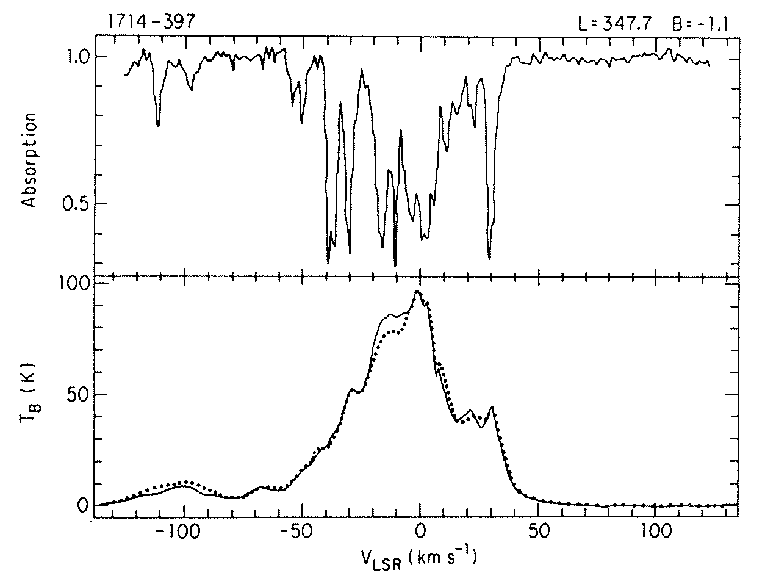
The HI Line: Radio Astronomy Breaks Out
1940: Jan Oort pushes Hendrik van de Hulst to see if theory predicts any spectral lines in the radio spectrum
1944: van de Hulst predicts a spectral line for neutral (atomic) hydrogen at 1420 MHz (21 cm), aka the HI line
                1951: detected by Ewen & Purcell,
                confirmed by Muller & Oort

Slide 12
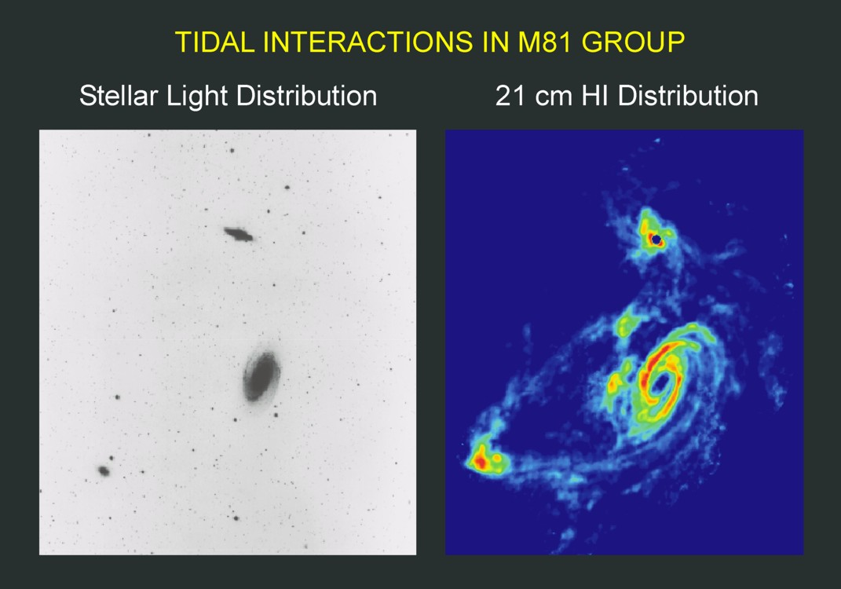
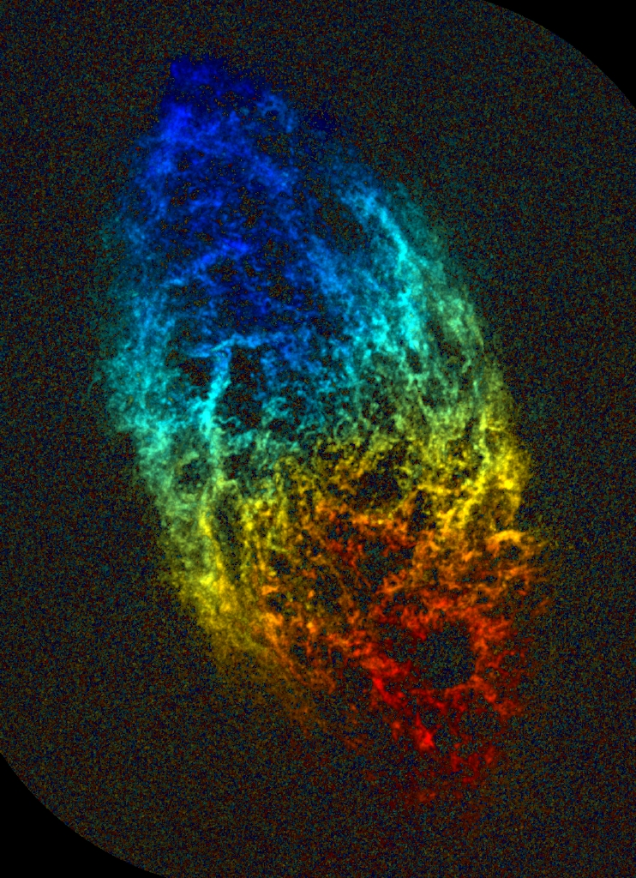
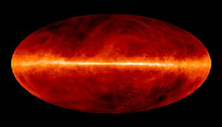
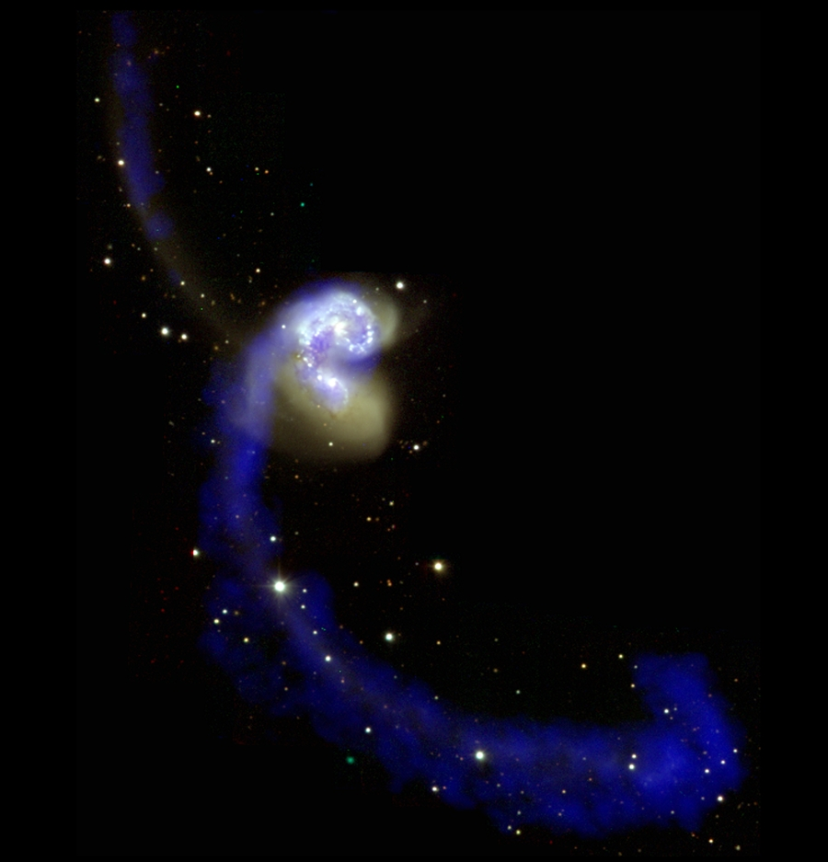
What's The Big Deal With HI?
(images: NRAO)
Neutral hydrogen is everywhere in
(and around) galaxies, but can only
be seen in HI
A different view of the universe!
Goes where visible light cannot, i.e.
through dust clouds that obscure
our view of most of the galaxy
  Spiral structure of the Milky Way confirmed via HI
Doppler shifts can be used to measure velocities

Slide 13
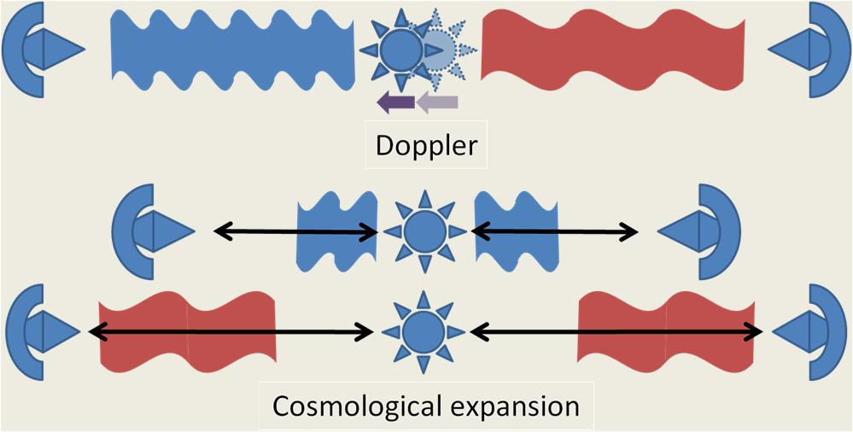
HI & Redshifts
As the Universe expands, the frequency of radiation travelling through it becomes lower
“redder” in the visible light band, hence redshift
  first observed by Edwin Hubble
Redshift (z) is a proxy for both distance and age, a high-z signal is both from far away (billions of light-years) and from far in the past (billions of years)
Measured by the frequency
shift in spectral lines
  per-object in optical
  en masse in radio!

Slide 14
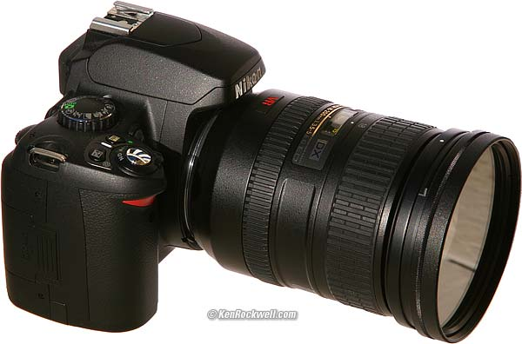
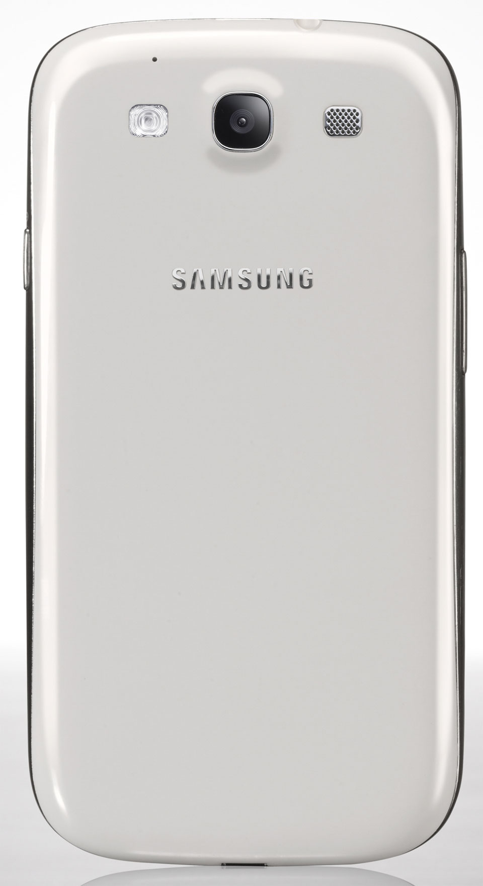
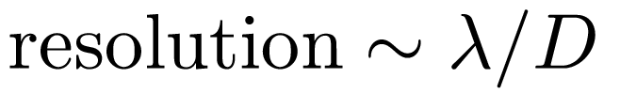
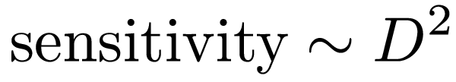
Size Matters
2007, 6 megapixels
2012, 8 megapixels
D
D

Slide 15
Resolution & Sensitivity
[Angular] resolution determines the smallest feature we can distinguish (smaller is better)
Sensitivity determines the faintest signal we can observe, and how quickly we can observe it (more is better, think ISO speed)
Aperture size D rules them all

Slide 16

A Typical Telescope
A digital camera with delusions of grandeur
Lens = mirror (metal reflects radio), focuses incoming radiation on a detector
D = aperture size
Biggest optical
scopes today:
D~10 m
D

Slide 17
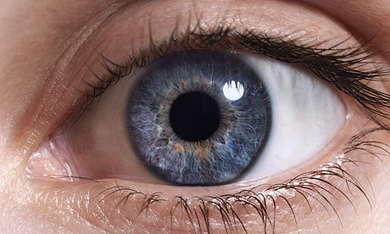
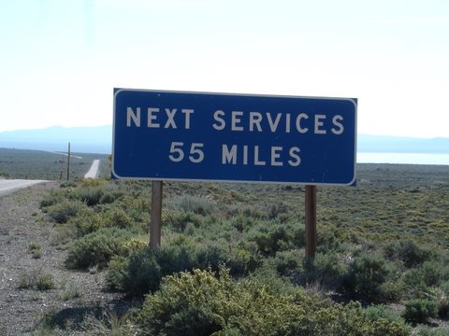
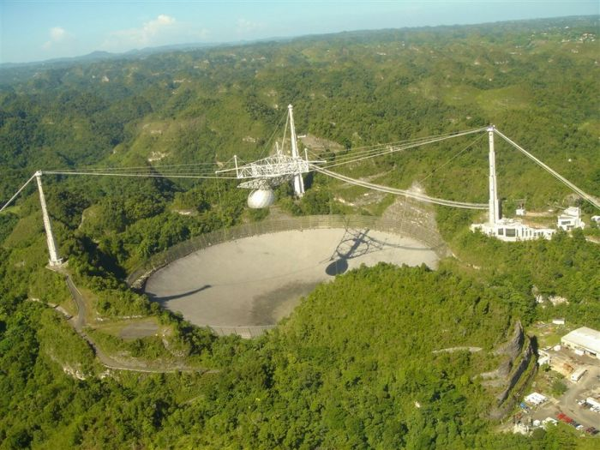
Wavelength Matters
Longer wavelength
= poorer resolution
At 21cm, a radio telescope
would need to be miles
across to match just a
human eye's resolution...
Biggest we have is 300m (Arecibo),
and even that took some “cheating”...
=

Slide 18
Aperture Synthesis To The Rescue
Radio wavelengths are very large compared to visible light
  >1,000,000 times longer
Therefore, a single radio telescope has very poor angular resolution
  25m dish ~ size of the full Moon
  Single “pixel” feeds (the detectors need to be correspondingly large!)
1950-60s: Sir Martin Ryle's group at Cambridge developed the technique of aperture synthesis interferometry, which worked around this problem.

Slide 19
How To Make An Interferometer 1
Start with a normal reflector telescope....

Slide 20

How To Make An Interferometer 2
Then break it up into sections...

Slide 21

How To Make An Interferometer 3
Replace the optical path with electronics

Slide 22

How To Make An Interferometer 4
Move the electronics outside the dish
...and add cable delays

Slide 23

How To Make An Interferometer 5
Why not drop the
pieces onto the ground?

Slide 24

How To Make An Interferometer 6
...all of them

Slide 25
How To Make An Interferometer 7
And now replace them with an array of proper radio dishes.
...and that's all! (?)
Well almost, what about the other pixels?

Slide 26

How Does Optical Imaging Do It?
This bit sees signal
from all directions,
added up together.
This bit sees signal
from all parts of the
dish surface,
added up together.
a Fourier transform

Slide 27
Fourier Transforms
=
The world's fastest computer for doing Fourier transforms
An optical imaging system implicitly performs two Fourier transforms:
  1. Signal over the aperture = FT of the sky
  2. Signal over focal plane = inverse FT of the aperture
A radio interferometer array measures (1)
  Then we do the second FT in software
  Hence, “aperture synthesis”

Slide 28
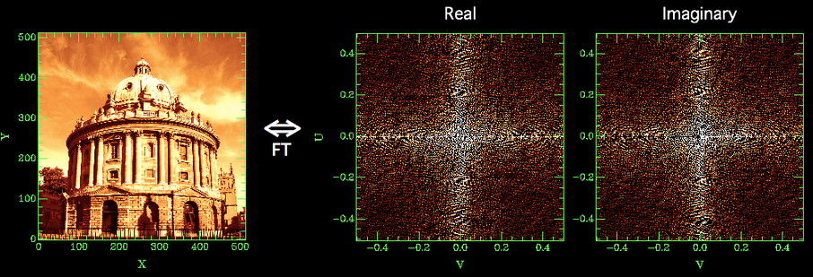
The Fourier (aka uv-) Plane
The Fourier plane (uv-plane) is a mathematically equivalent representation of the image plane, we can recover one from the other via Fourier transforms
One pair of antennas (baseline) samples one point in the uv-plane (one complex visibility)
An optical system (e.g. your eye) samples the entire plane at once

Slide 29
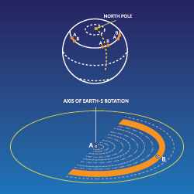
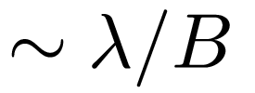
Earth Rotation Aperture Synthesis
Each baseline samples one uv-point
An array of N antennas will
sample N(N-1)/2 points
This is usually not enough to
recover a good image, but...
As the Earth rotates, each baseline's
uv-point is rotating as well
  ...while the Universe is (mostly) still
Over several hours, we can sample most of the uv-plane with even a modest number of antennas
Resolution determined by longest baseline:

Slide 30
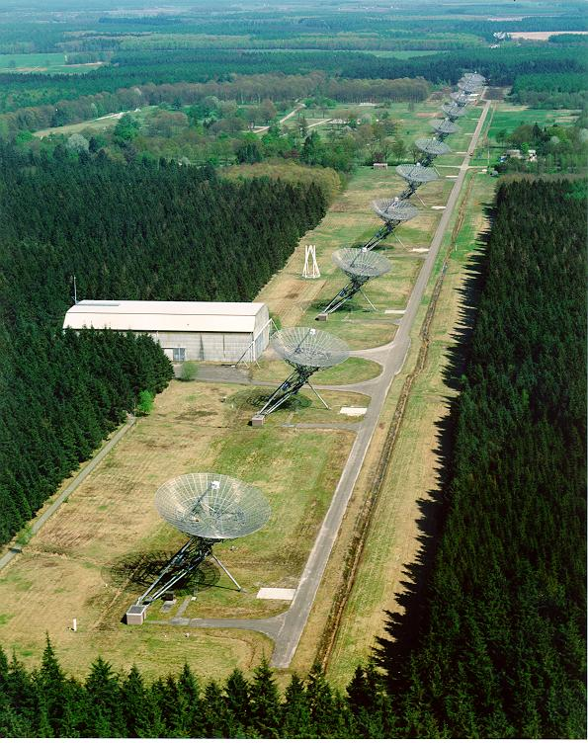
Some Real-Life Arrays: WSRT
WSRT (Westerbork Synthesis Radio Telescope), The Netherlands
14x25m dishes on an East-West line
Max baseline 2.7km
Completed 1970, upgraded since
World record dynamic
range, still

Slide 31
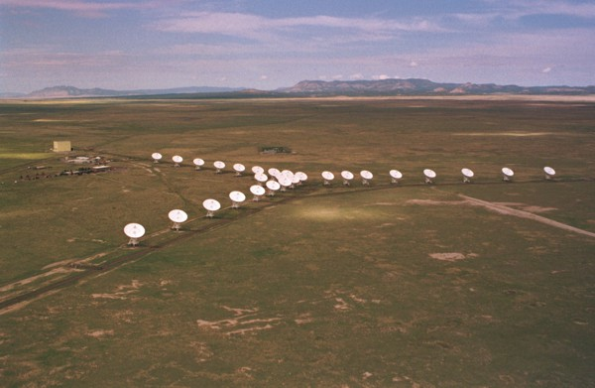
Some Real-Life Arrays: JVLA
JVLA (Karl G. Jansky
Very Large Array),
New Mexico, USA
27x25m dishes
Reconfigurable (via
rail tracks) to a longest
baseline of 36km
Completed in 1980 (as simply the “VLA”),
recently upgraded and renamed
The most successful radio telescope in the world, in terms of science produced

Slide 32
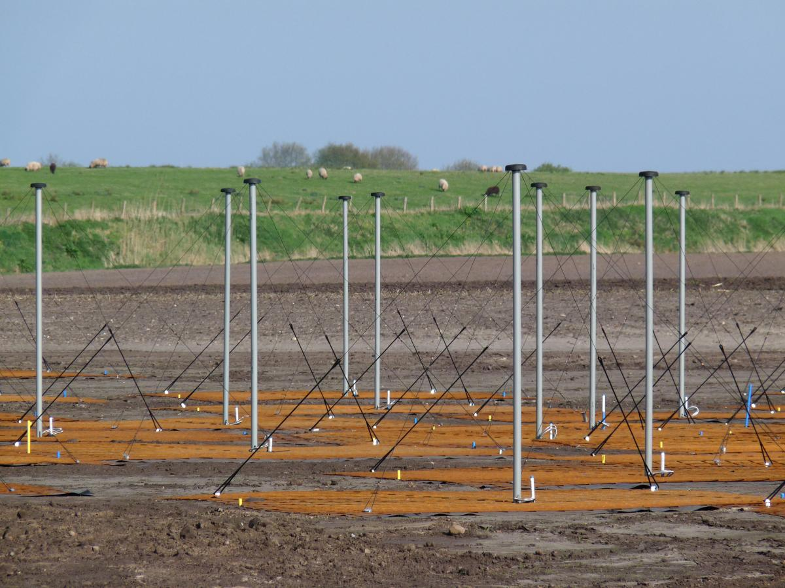
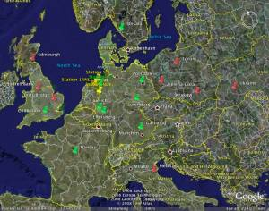
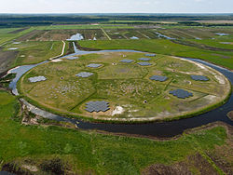
Some Real-Life Arrays: LOFAR
Low Frequency Array (LOFAR)
36 stations (not dishes!) across The Netherlands
8 (and counting) international stations
Inaugurated 2010

Slide 33
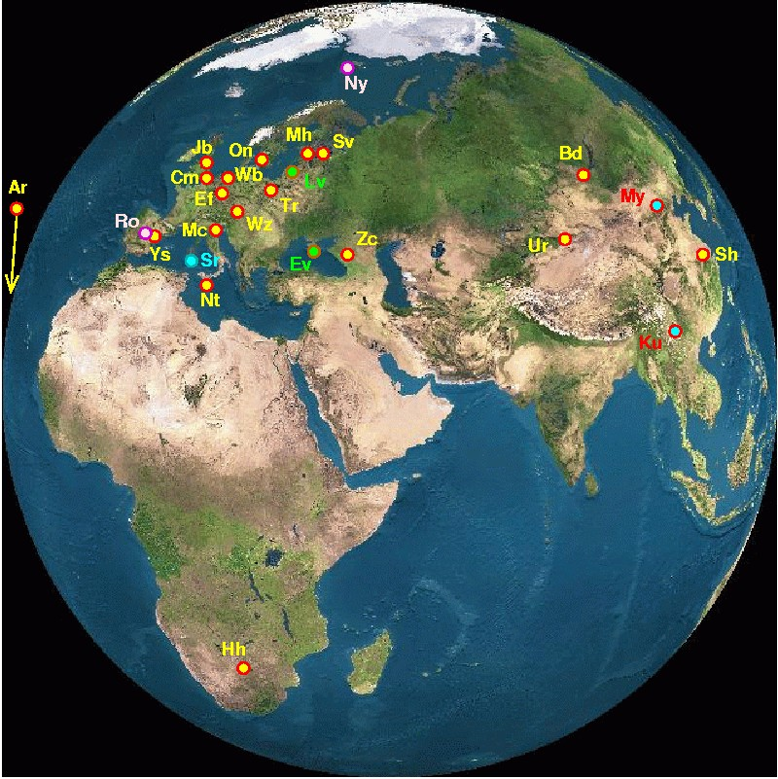
Some Real-Life Arrays: EVN & VLBA
[not only] European VLBI
(Very Long Baseline Interferometry) Network
Connects radio telescopes
around the world into an
ad hoc interferometer
Baselines of thousands of
kilometres
US analogue: VLBA
(Very Long Baseline Array)
African VLBI project will fill in the North-South gaps

Slide 34
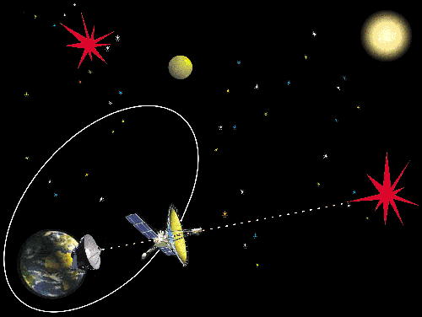
Space VLBI
Interferometry between spacecraft and ground-based dishes
Two specialized missions:
  VSOP (Japan),
  launched 1997
  RadioAstron
  (Russia),
  launched
  2011

Slide 35
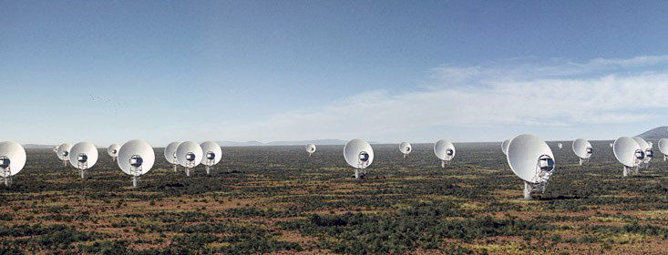
Future Arrays: MeerKAT (2016)
64x13.5m dishes, 8km longest baseline
Now under construction in the Karoo

Slide 36
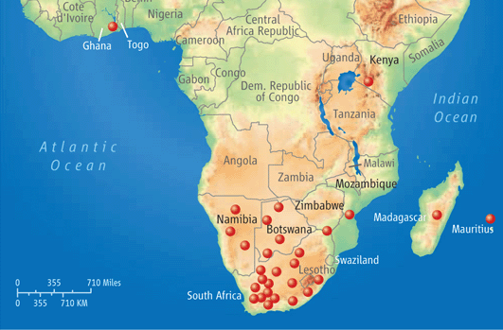
SKA (2024)
Dish component: ~3000x15m dishes (= 1 km²)
  Half of them within a 5km “core” in the Karoo
Longest baselines to 3000 km
2020: Phase One (SKA1) with 250 dishes
(incorporates
MeerKAT)

Slide 37

Why SKA?
Aperture synthesis has nailed the resolution problem
  VLBI (and Space VLBI) routinely achieves higher res than optical astronomy
Sensitivity still limited by collecting area D²
100x 12m
dishes
100m
dish
25m
dish
300m
dish
1km

Slide 38
Challenges Of The SKA
Engineering: dishes, arrays, optical fibre, electric power...
Computational
  Data rate: 10-100 times today's worldwide internet traffic
  Will require a future-world-class supercomputer
  Only feasible if both Moore's Law holds out, and we make regular algorithmic advances...
Mathematical
  ...those very advances. Need better methods and better math!

Slide 39
Why Is It Difficult?
Gaps in the uv-plane:
  At the end of the day, we're still trying to fill a huge “virtual aperture” with small dishes
  Gaps in the uv-plane sampling are unavoidable
  Fundamentally missing information
  Can never recover the image fully
Every measurement is distorted by the instrument response, needs to be calibrated.
  And some measurements affected by man-made radio interference (RFI)
  The “Fourier scramble”: one bad point in the Fourier plane affects all points in the image plane

Slide 40
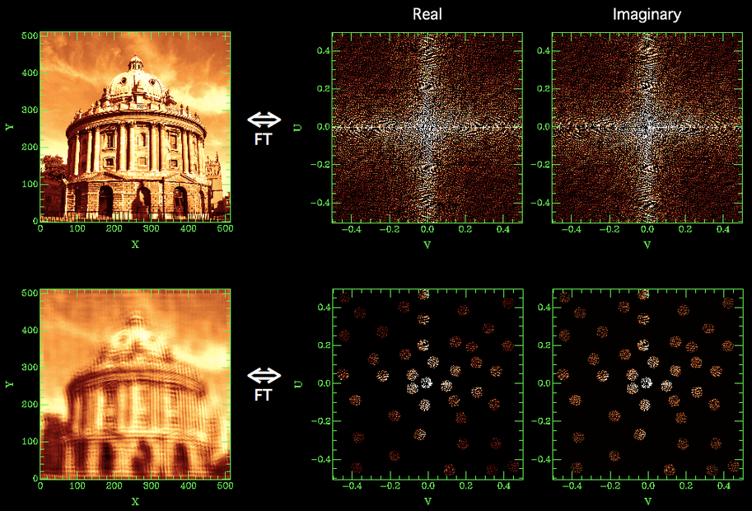
Gaps In The uv-Plane

Slide 41


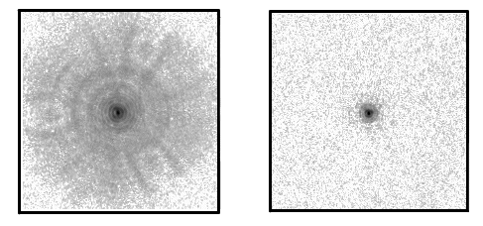
Gaps ⇒ Point Spread Function
Response to a point source: Point Spread Function (PSF)
Observed “dirty image” is convolved with the PSF
Structure in the PSF = uncertainty in the flux distribution (corresponding to missing data in the uv-plane)
PSF of the WSRT.
The regular rings are due to the regular spacing of its antennas in the
East-West direction.
PSF of MeerKAT
PSF of the Hubble Space Telescope
before & after servicing mission

Slide 42

Deconvolution: from dirty to clean images
Real-life WSRT “dirty” image
Dirty image dominated by PSF sidelobes from the strongest sources
Deconvolution required to get at the faint stuff underneath.
A whole continuum of skies fits the dirty image (pick any value for the missing uv-components)
Deconvolution picks one = interpolates the missing info from extra assumptions (e.g.: “sources are point-like”).

Slide 43

Distorted Measurements
One point-like source, but observed with complex phase errors
  Ionosphere, troposphere, electronics
In the uv-plane, phase encodes information about location
Phase errors tends to spread the flux around
Calibration of complex gains required before we can see anything at all!

Slide 44

Stone-Age Calibration
(First-Generation, or 1GC)
Calibrate gains using a known calibrator source
Move antennas to target, cross your fingers, and hope that everything stays stable enough to get an image
Dynamic range:
~100:1
Observed
data
Known
calibrator
model
Gain of
baseline
(i.e. antenna pair)
p-q

Slide 45
1980: The Selfcal Revolution (2GC)
A very simple realization: per-baseline gains are actually products of per-antenna complex gains!
N(N-1)/2 visibilities >> N gains
  Start with simple M
  Solve for g's
  Improve M, rinse & repeat
dynamic range > 10⁶:1
Huge body of experience suggests that this works rather well, BUT there's no formal proof (!!!) Current practice is a collection of ad hoc methods, dark art and lore passed down the generations in what is virtually an oral tradition.

Slide 46


The Fundamental Limit of 2GC...
The calibration equation
assumes the unknown gains
are direction-independent
  ...when they are at best only approximately so
  But incorporating directional dependence is devilishly tricky due to the nature of the Fourier transform
Example: ionosphere
  Introduces phase errors which
  appear to “shift” the sources
  2GC can calibrate the overall
  shift, but not the differential
  shifts

Slide 47
Why Is This a Problem Now?
Older telescopes are also prone to direction-dependent effects
  but if your sensitivity is not high enough to even see the distortions, then who cares?
The SKA will have record sensitivity
  Which means it will also be sensitive to far more subtle errors
Also, it will be built from “cheap junk”....

Slide 48

The Past: Massive Overengineering
(Built For 1GC, used with 2GC)

Slide 49

The Future: Cheap Junk e.g. Four Sticks In The Ground (+Software)

Slide 50

...e.g. Dishes Made Of Plastic
(+Other Software)

Slide 51
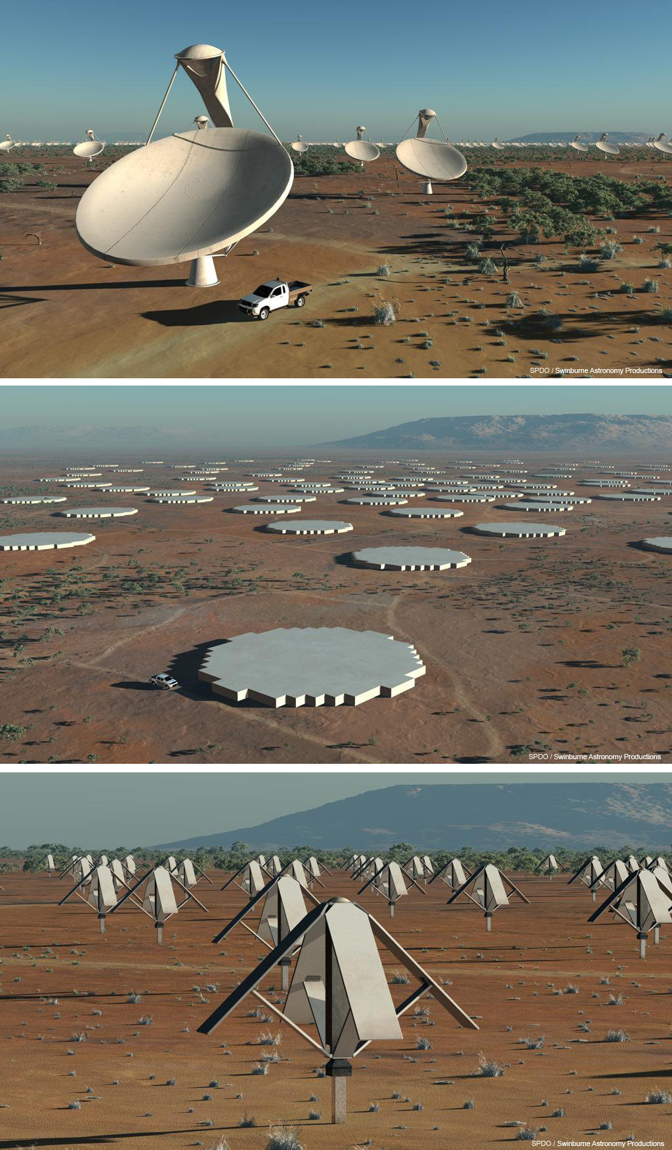
SKA Components
SKA is actually three instruments in one, for three frequency ranges
  SKA-Low: sparse aperture arrays, 70-500 MHz,
  Australia
  SKA-Mid: dense aperture arrays,
  500-800 MHz,
  South Africa
  SKA-Dishes: 500 MHz – 10 GHz,
  South Africa
SKA-Low is about 30% of the instrument

Slide 52
SKA Headline Science
Probing the Dark Ages
Galaxy evolution, cosmology and dark energy
Cosmic magnetism
Strong field tests of gravity (“Was Einstein Right?”)
The Cradle Of Life

Slide 53
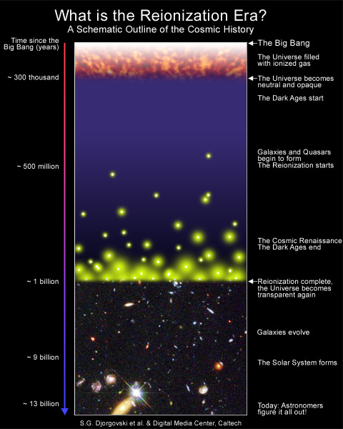
Probing The Dark Ages
Direct imaging of HI at extremely high redshift (i.e. at <200 MHz – down from 1420!) will open a window on the Epoch of Reionization (EoR)

Slide 54
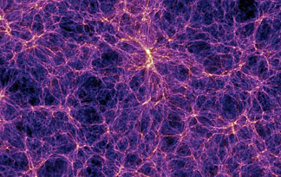
Galaxy Evolution, Cosmology, Dark Energy
HI is the main ingredient of galaxies, and can be observed unobscured. “Cosmic census”: how do galaxies form and evolve?
On very large scales, galaxies tend to form in sheets and
filaments of a “cosmic web”.
Can be observed in HI, with redshifts giving a 3D view!

Slide 55
Full Circle?
The EoR, the Cosmic Web, and baryon acoustic oscillations (BAOs) are some of the largest-scale and most distant “things” we can possibly observe
Yet their shape is determined by some of the “smallest” and fundamental ingredients of the universe, such as dark matter and dark energy
Unique probes of fundamental physics!

Slide 56
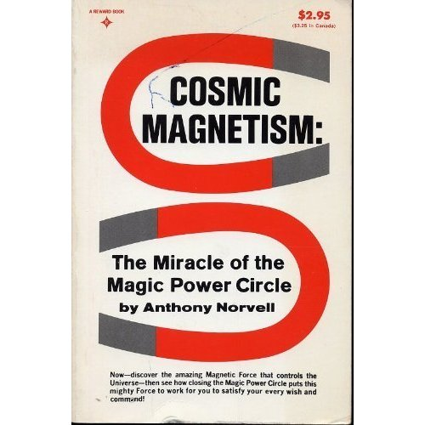
Cosmic Magnetism
Magnetic fields are vital ingredients of many astrophysical phenomena
… yet the origin, evolution
and structure of cosmic
magnetism is still unclear
At SKA sensitivities, can be
probed with very accurate
radio polarization
measurements

Slide 57
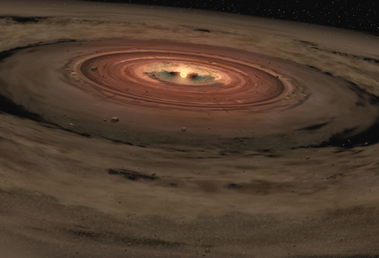

The Cradle Of Life
The SKA will be able to
image dust-obscured
protoplanetary disks, thus
directly observing the
process of planet formation
Astrobiology: detection
of complex molecules,
study of prebiotic chemical evolution in interstellar clouds
                Sensitive enough to detect airport radar up to
                ~50 light years away

Slide 58
Last But Not Least, Pulsars
“...the greatest astronomical discovery of the twentieth century." (I. Shklovsky)
Detected in 1967 by Jocelyn Bell, a PhD student at Cambridge
  Radio pulse with a stable 1.33 second periodicity
  Initially dubbed “LGM” for “Little Green Men”
  ...but other pulsating sources quickly discovered
  ~2000 known by now
Earned Bell's supervisor the Nobel Prize in physics
  (Cynically called the No-Bell prize...)

Slide 59
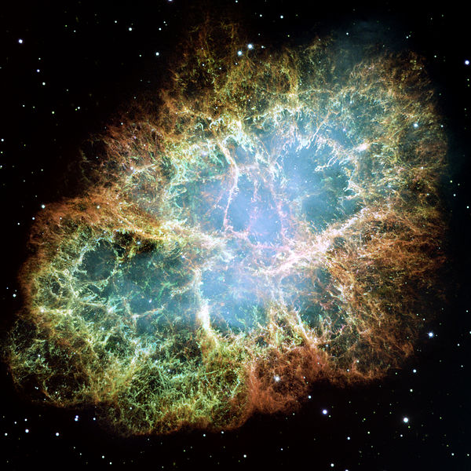
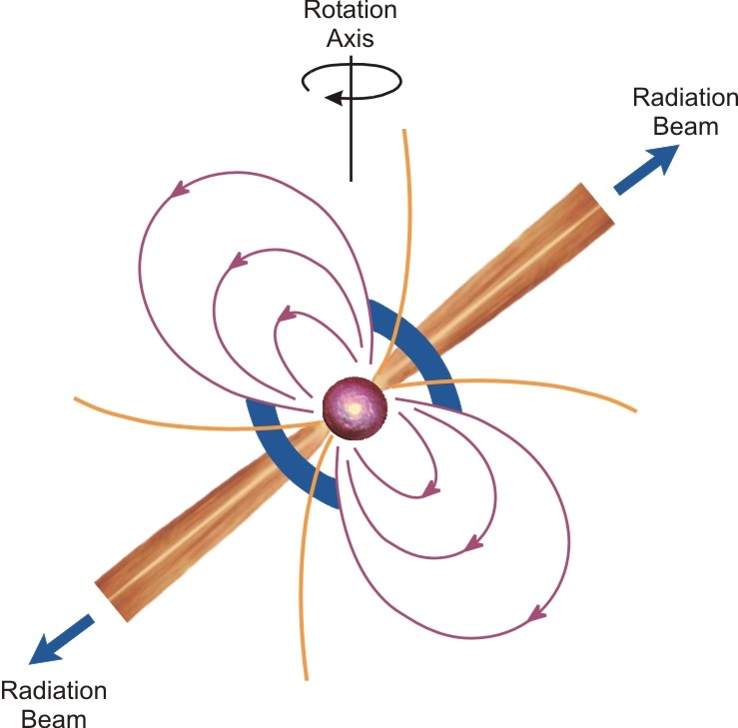
Pulsars = Neutron Stars
Massive star → supernova → expanding nebula + collapsed core of neutron matter
Core is rapidly rotating and highly magnetized
Emits radiation in a tight beam along the magnetic axis
Crab Nebula (supernova of 1054)

Slide 60
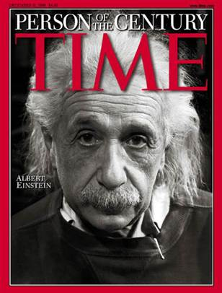
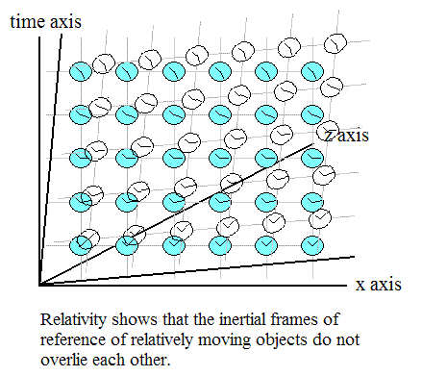
Pulsars & GR
General relativity describes the structure of spacetime and gravity, including such extreme phenomena
as black holes and gravitational waves.
These could be probed by observing
lattices of clocks
Pulsars are natural clocks!
SKA should detect 10,000s pulsars
Its sensitivity will allow for extremely accurate timing

Slide 61
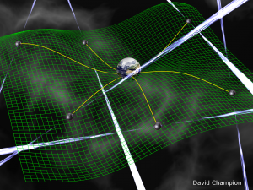
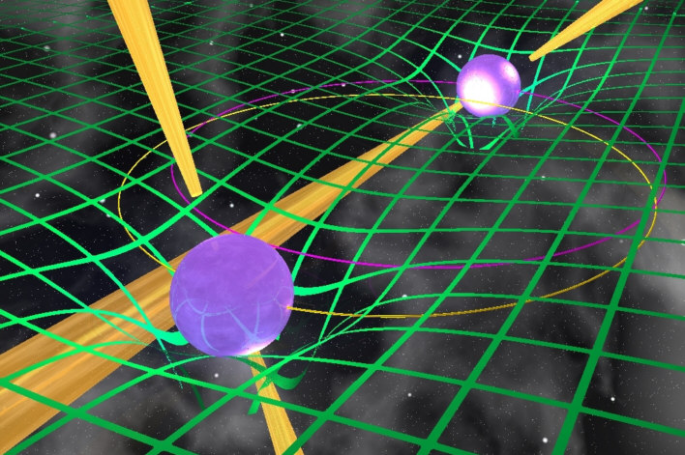
Gravitational Waves & Strong Field Tests
A “timing array” of pulsars should allow for direct observation of gravitational waves
image: Michael Kramer
Double pulsars and
pulsars near black
holes probe extreme gravitational regimes –
if Einstein was wrong,
this is where we find out.

Slide 62
Exploration Of The Unknown
These are all “planned discoveries”, which feels a little bit boring
However, mega-projects such as the SKA need to build a science case up front to secure funding
  See also LHC and the Higgs boson
But some of the most exciting discoveries in science have been completely unplanned
What is the most important expletive in science?

Slide 63
Eureka!

